Slide 1

Advanced Topics in Economic Evaluation and Healthcare
Lecture #6: Discounting

Slide 2
Lecture Overview
This lecture will provide an overview of theoretical issues in discounting.
We will discuss:
  The Reason to Discount.
  The Keeler-Cretin Paradox.
  The Ramsey Equation\
  Why Sensitivity analysis with discount rates are crucial.
  Valuing Treatment Decisions under ROI.
WARNING: THIS LECTURE WILL BE AMONG THE LEAST APPLICABLE

Slide 3
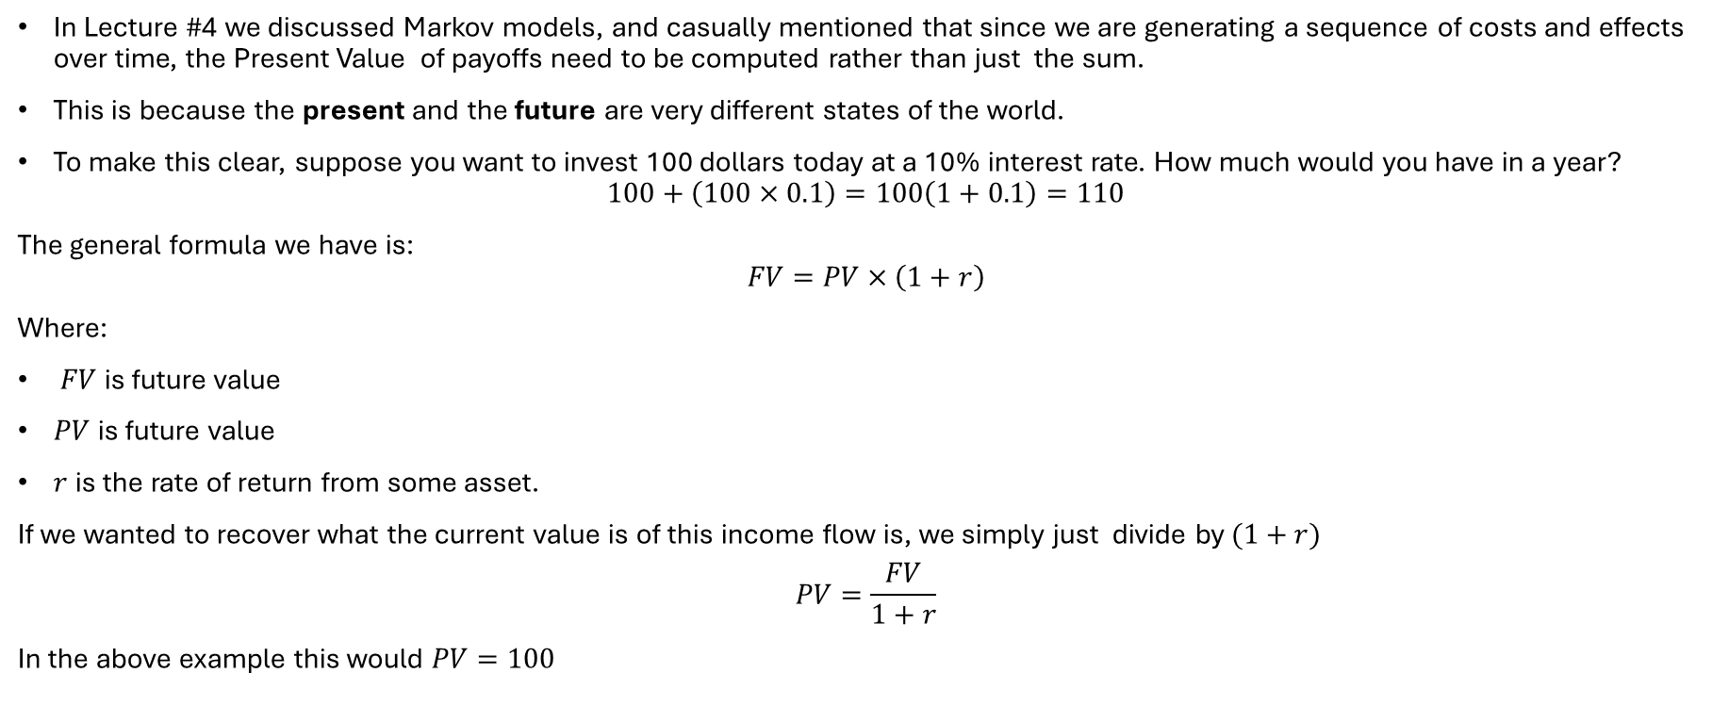
Why We Discount
In Lecture #4 we discussed Markov models, and casually mentioned that since we are generating a sequence of costs and effects over time, the Present Value of payoffs need to be computed rather than just the sum.
This is because the present and the future are very different states of the world.
To make this clear, suppose you want to invest 100 dollars today at a 10% interest rate. How much would you have in a year?
$100+\left(100×0.1\right)=100\left(1+0.1\right)=110$
The general formula we have is:
$$FV=PV×\left(1+r\right)$$
Where:
$FV$ is future value
$PV$ is future value
$r$ is the rate of return from some asset.
If we wanted to recover what the current value is of this income flow is, we simply just divide by $(1+r)$
$$PV=\frac{FV}{1+r}$$
In the above example this would $PV=100$

Slide 4
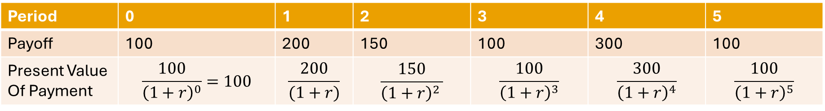
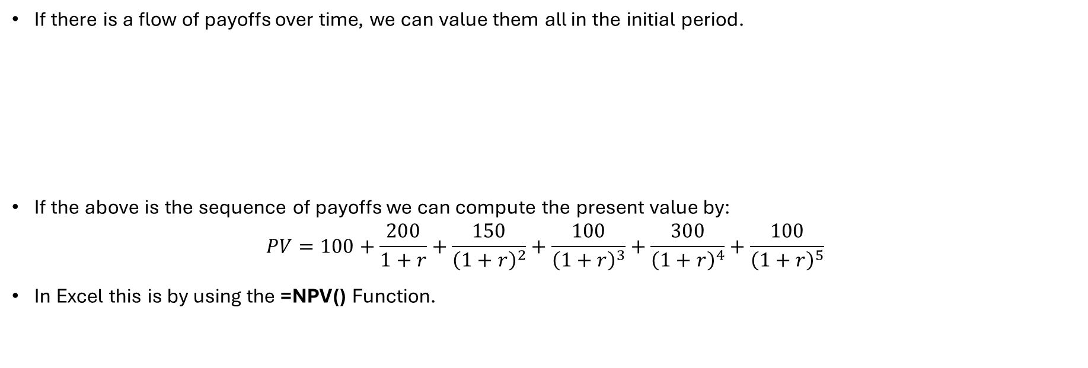
Sequences of Benefits and Costs
If there is a flow of payoffs over time, we can value them all in the initial period.
If the above is the sequence of payoffs we can compute the present value by:
$PV=100+\frac{200}{1+r}+\frac{150}{{\left(1+r\right)}^{2}}+\frac{100}{{\left(1+r\right)}^{3}}+\frac{300}{{\left(1+r\right)}^{4}}+\frac{100}{{\left(1+r\right)}^{5}}$
In Excel this is by using the =NPV() Function.
Period | 0 | 1 | 2 | 3 | 4 | 5
Payoff | 100 | 200 | 150 | 100 | 300 | 100
Present Value Of Payment | $$\frac{100}{{\left(1+r\right)}^{0}}=100$$ | $$\frac{200}{(1+r)}$$ | $$\frac{150}{{\left(1+r\right)}^{2 }}$$ | $$\frac{100}{{\left(1+r\right)}^{3}}$$ | $$\frac{300}{{\left(1+r\right)}^{4}}$$ | $$\frac{100}{{\left(1+r\right)}^{5}}$$

Slide 5
On the intuition of Present Value and QALYS
Discounting costs makes sense.
This is because dollars can be invested and earn a return.
What about health states? Theres no market where you can trade your health or invest it in the same way as we do for financial goods!
So how do we discount if we do so at all?
  The wrong answer: Don’t Discount QALYS at all.
  The right answer: The Ramsey Equation

Slide 6
The Keeler-Cretin Paradox

Slide 7


“QALYS Are Not Financial” and the Keeler-Cretin Paradox
Formulated by Emmett Keeler and Shan Cretin in 1983, the paradox addresses the mathematical conflict that arises if health outcomes (e.g., Quality-Adjusted Life Years or saved lives) are discounted at a lower rate than costs (or if costs are discounted and health effects are not discounted at all).
Many health economists argue that future health should be discounted at a lower rate than because health is not a financial product which can be invested as other forms of capital. (It simply cannot be traded!).
It results in the following result:
ANY HEALTH TECHNOLOGY CAN BE COST EFFECTIVE WITH ENOUGH DELAY
Emmet Keeler
Shan Cretin

Slide 8
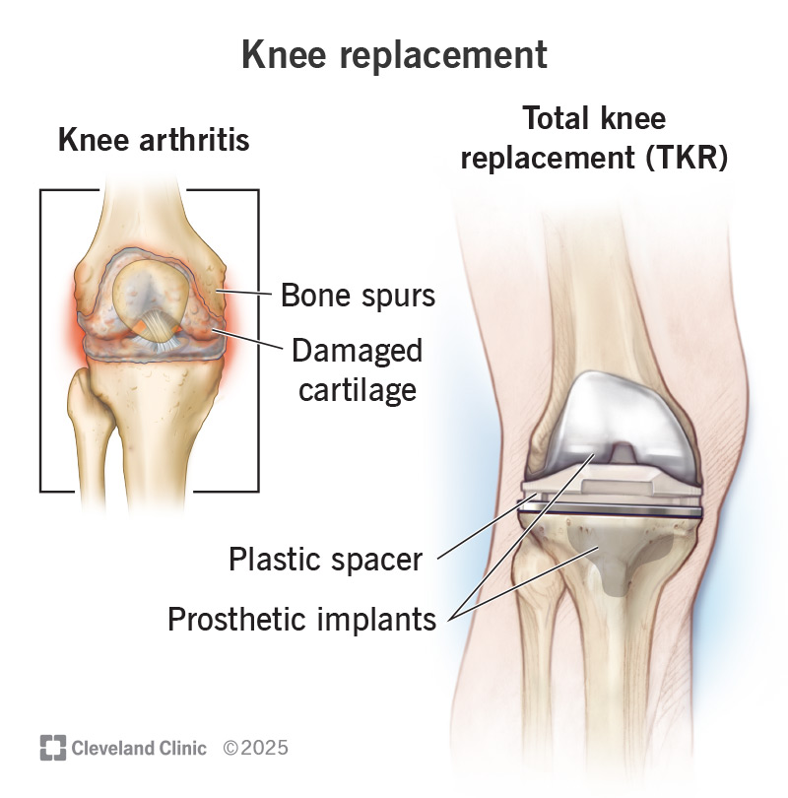
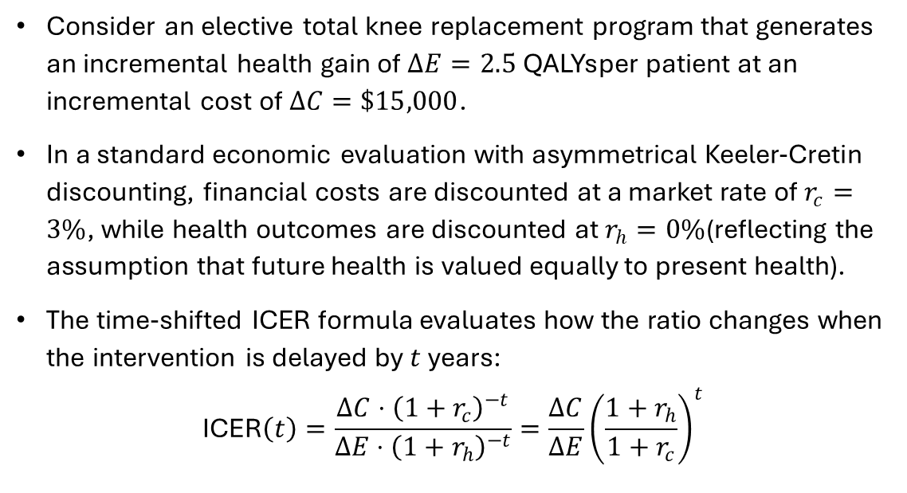
An Example of the Keeler-Cretin Paradox
Consider an elective total knee replacement program that generates an incremental health gain of $ΔE=2.5\text{ QALYs}$per patient at an incremental cost of $ΔC=\$15,000$.
In a standard economic evaluation with asymmetrical Keeler-Cretin discounting, financial costs are discounted at a market rate of $r_{c}=3\%$, while health outcomes are discounted at $r_{h}=0\%$(reflecting the assumption that future health is valued equally to present health).
The time-shifted ICER formula evaluates how the ratio changes when the intervention is delayed by $t$years:
$$\text{ICER}\left(t\right)=\frac{ΔC⋅{\left(1+r_{c}\right)}^{−t}}{ΔE⋅{\left(1+r_{h}\right)}^{−t}}=\frac{ΔC}{ΔE}{\left(\frac{1+r_{h}}{1+r_{c}}\right)}^{t}$$

Slide 9
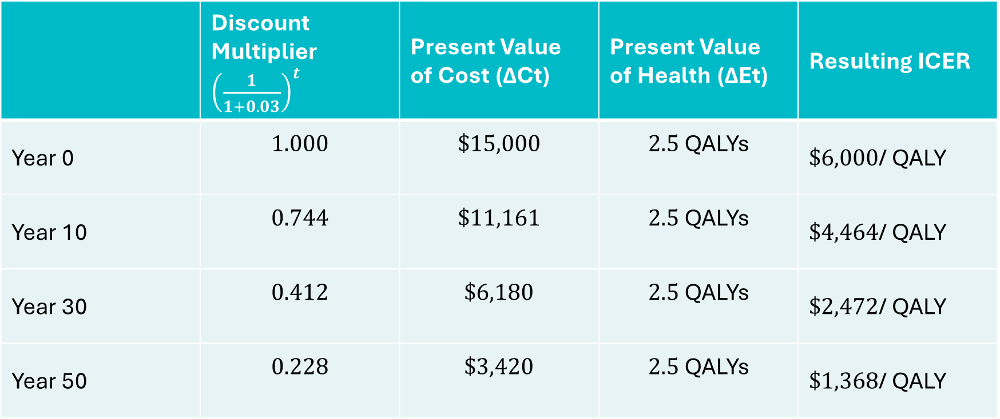
Numerical Results
 | Discount Multiplier${\left(\frac{1}{1+0.03}\right)}^{t}$ | Present Value of Cost (ΔCt​) | Present Value of Health (ΔEt​) | Resulting ICER
Year 0 | $$1.000$$ | $$\$15,000$$ | $$2.5\text{ QALYs}$$ | $\$6,000$/ QALY
Year 10 | $$0.744$$ | $$\$11,161$$ | $$2.5\text{ QALYs}$$ | $\$4,464$/ QALY
Year 30 | $$0.412$$ | $$\$6,180$$ | $$2.5\text{ QALYs}$$ | $\$2,472$/ QALY
Year 50 | $$0.228$$ | $$\$3,420$$ | $$2.5\text{ QALYs}$$ | $\$1,368$/ QALY

Slide 10
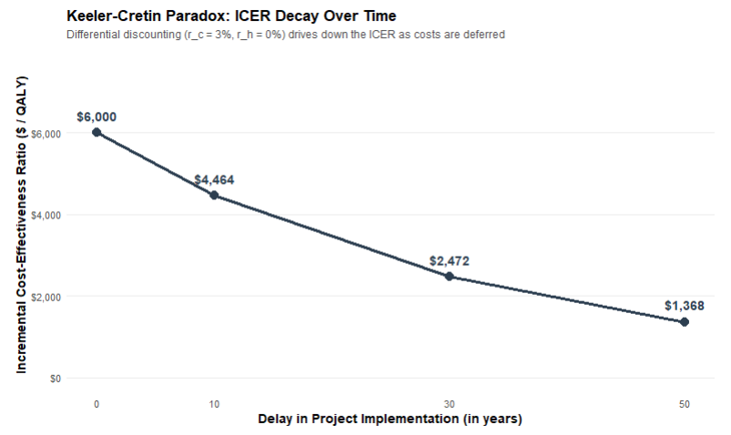

Slide 11
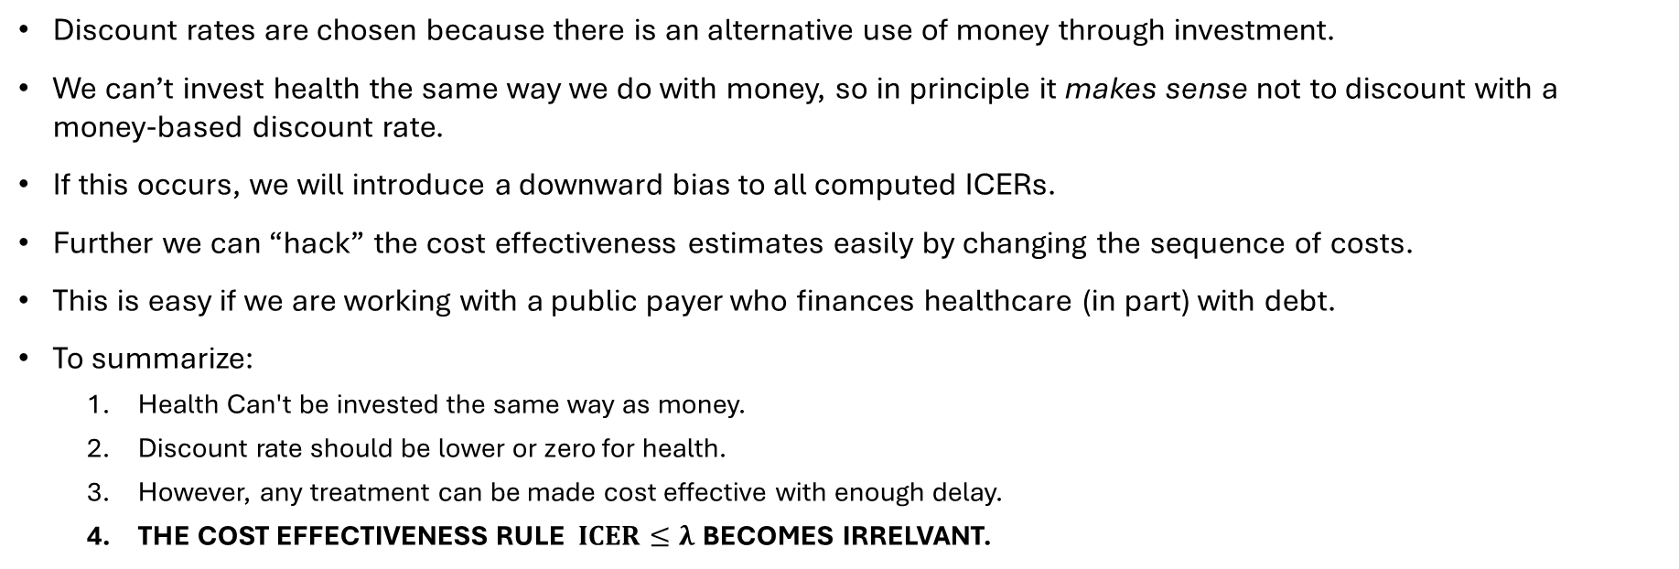
Why is the Keeler-Cretin Paradox a Paradox?
Discount rates are chosen because there is an alternative use of money through investment.
We can’t invest health the same way we do with money, so in principle it makes sense not to discount with a money-based discount rate.
If this occurs, we will introduce a downward bias to all computed ICERs.
Further we can “hack” the cost effectiveness estimates easily by changing the sequence of costs.
This is easy if we are working with a public payer who finances healthcare (in part) with debt.
To summarize:
  Health Can't be invested the same way as money.
  Discount rate should be lower or zero for health.
  However, any treatment can be made cost effective with enough delay.
  THE COST EFFECTIVENESS RULE $ICER≤λ$ BECOMES IRRELVANT.

Slide 12
The Ramsey Equation

Slide 13
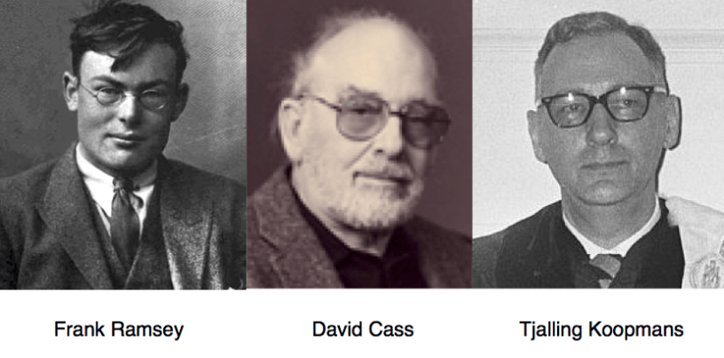
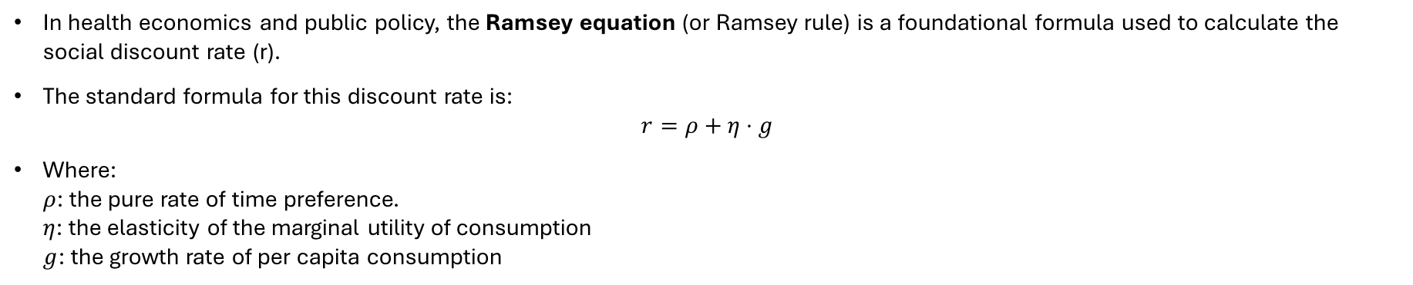
The Ramsey Equation
In health economics and public policy, the Ramsey equation (or Ramsey rule) is a foundational formula used to calculate the social discount rate (r).
The standard formula for this discount rate is:
$r=ρ+η⋅g$
Where:
$ρ$: the pure rate of time preference.
$η$: the elasticity of the marginal utility of consumption
$g$: the growth rate of per capita consumption

Slide 14

$ρ$the pure rate of time preference.
The first part of the ramsey equation is the rate of “pure time preference”.
This captures intrinsic human impatience—how much we prefer utility right now over utility in the future, all else equal.
In practice: we calibrate this with the baseline country level hazard rate of death (i.e. the instantaneous probability that individuals face dying in Canada).
This is often a very small number in developed countries.
Source: Crude Death Rate Canada (World Bank)

Slide 15
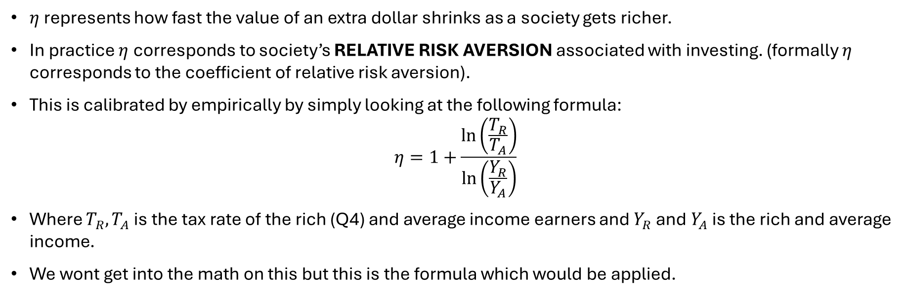

$η$the elasticity of the marginal utility of consumption
$η$ represents how fast the value of an extra dollar shrinks as a society gets richer.
In practice $η$ corresponds to society’s RELATIVE RISK AVERSION associated with investing. (formally $η$ corresponds to the coefficient of relative risk aversion).
This is calibrated by empirically by simply looking at the following formula:
$η=1+\frac{\ln\left(\frac{T_{R}}{T_{A}}\right)}{\ln\left(\frac{Y_{R}}{Y_{A}}\right)}$
Where $T_{R}, T_{A}$ is the tax rate of the rich (Q4) and average income earners and $Y_{R}$ and $Y_{A}$ is the rich and average income.
We wont get into the math on this but this is the formula which would be applied.

Slide 16
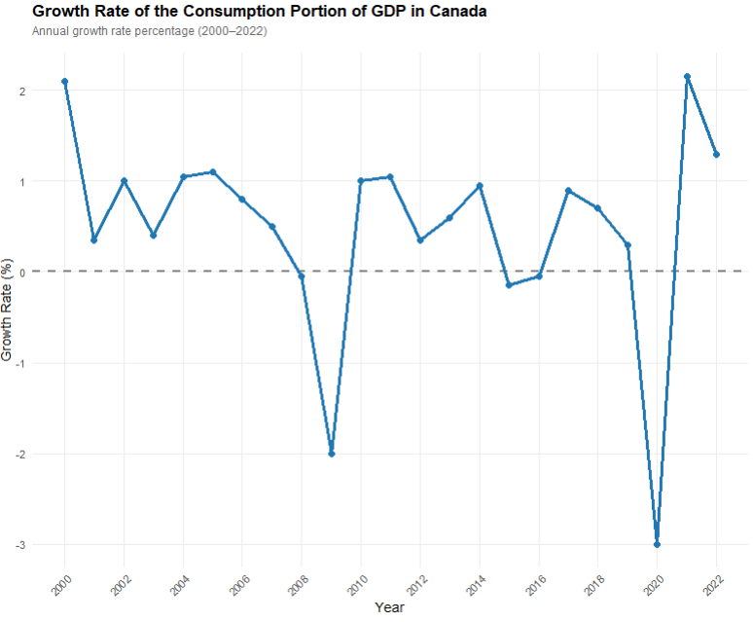

$g$the growth rate of per capita consumption
This is a country level estimate that considers the growth exclusively in the consumption component of GDP.
It captures this natural idea that there are other assets (which may not be related to health) that yield a baseline return.
We need to account for the opportunity cost associated with forgoing all other possible household improving investments.

Slide 17
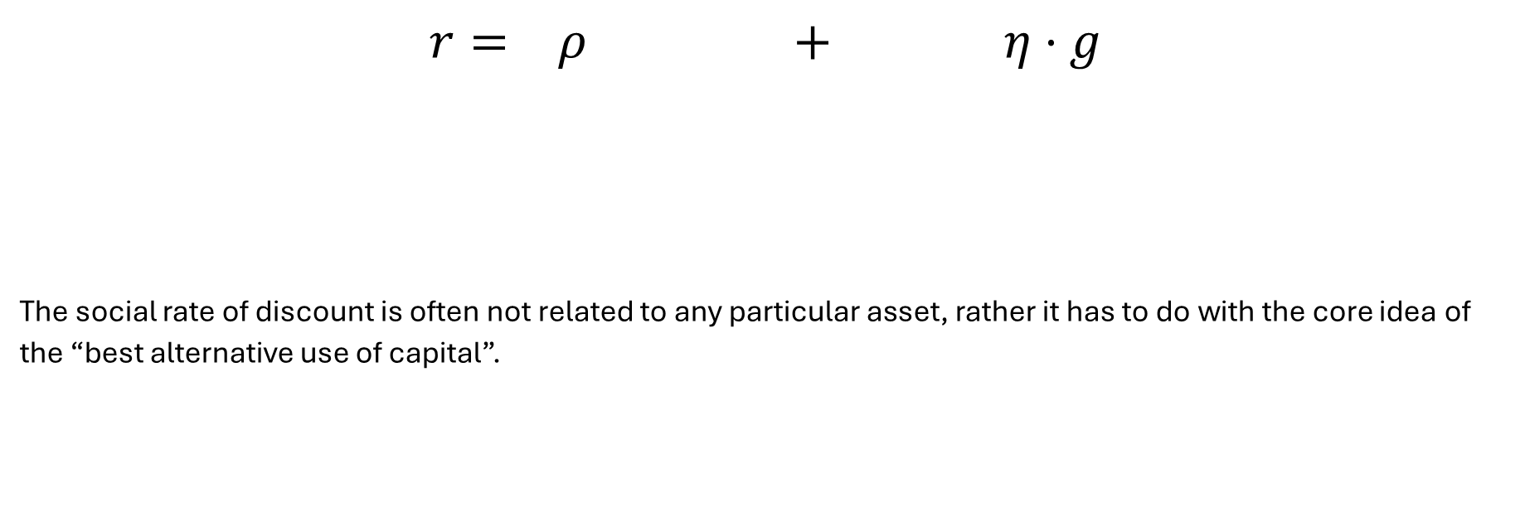
What the Ramsey equation is really about.
Social Discount Rate
$$r= ρ + η⋅g$$
The social rate of discount is often not related to any particular asset, rather it has to do with the core idea of the “best alternative use of capital”.
Risk of Death
Risk adjusted return
from other assets

Slide 18
Discount Rates and the ICER

Slide 19
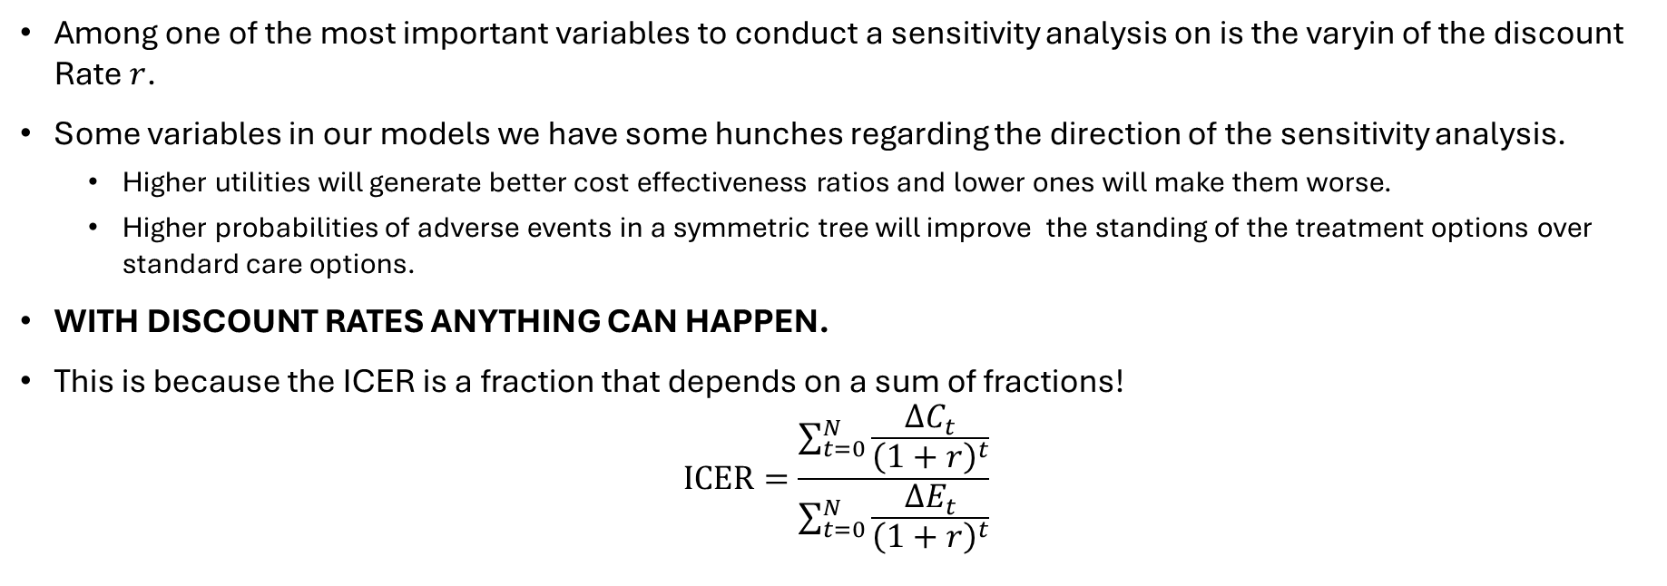
Changing Discount Rates? Anything can happen!
Among one of the most important variables to conduct a sensitivity analysis on is the varyin of the discount Rate $r$.
Some variables in our models we have some hunches regarding the direction of the sensitivity analysis.
  Higher utilities will generate better cost effectiveness ratios and lower ones will make them worse.
  Higher probabilities of adverse events in a symmetric tree will improve the standing of the treatment options over standard care options.
WITH DISCOUNT RATES ANYTHING CAN HAPPEN.
This is because the ICER is a fraction that depends on a sum of fractions!
$ICER=\frac{\sum_{t=0}^{N}{\frac{ΔC_{t}}{{\left(1+r\right)}^{t}}}}{\sum_{t=0}^{N}{\frac{ΔE_{t}}{{\left(1+r\right)}^{t}}}}$

Slide 20
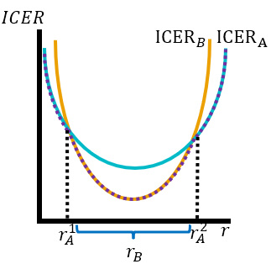
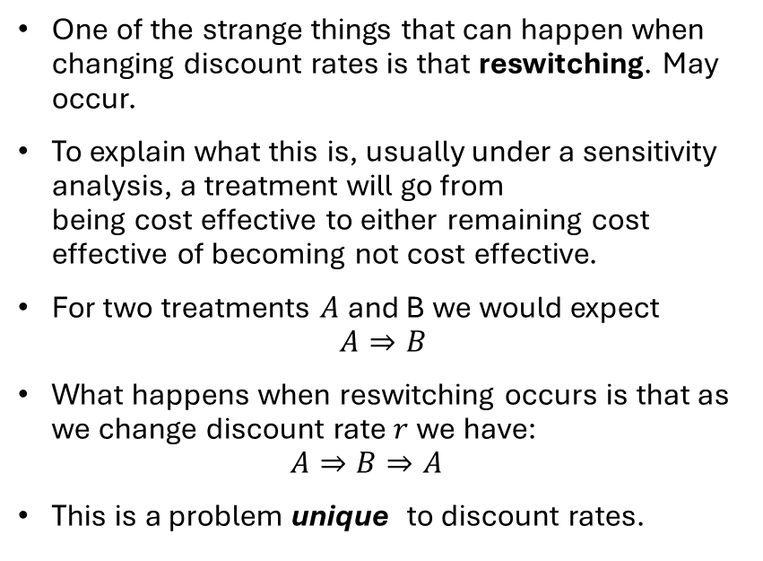
“Reswitching”
One of the strange things that can happen when changing discount rates is that reswitching. May occur.
To explain what this is, usually under a sensitivity analysis, a treatment will go from
being cost effective to either remaining cost effective of becoming not cost effective.
For two treatments $A$ and B we would expect
$A⇒B$
What happens when reswitching occurs is that as we change discount rate $r$ we have:
$A⇒B⇒A$
This is a problem unique to discount rates.

Slide 21
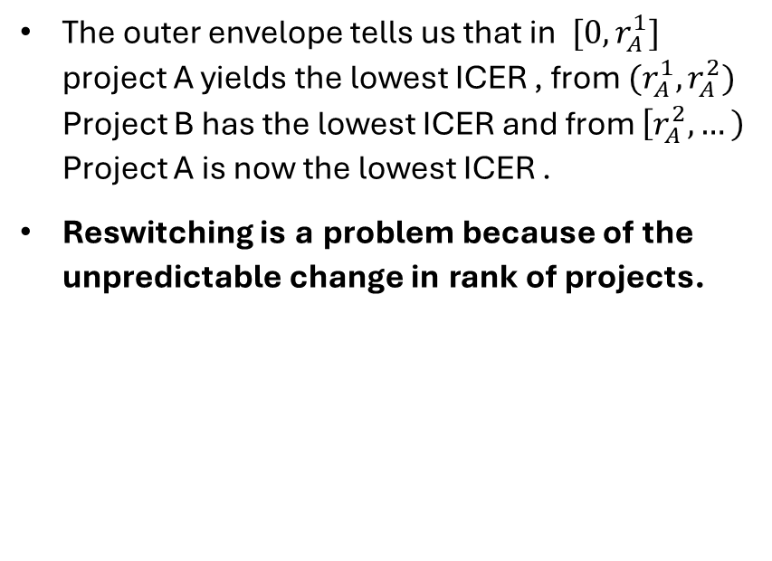
“Reswitching”
The outer envelope tells us that in $[0,r_{A}^{1}]$ project A yields the lowest ICER , from $(r_{A}^{1},r_{A}^{2})$ Project B has the lowest ICER and from $\left[r_{A}^{2},…\right)$ Project A is now the lowest ICER .
Reswitching is a problem because of the unpredictable change in rank of projects.

Slide 22
Why guidelines changing on discount rates are a bad idea
Economic evaluations is research that is relevant to both budget holders and academics.
They are relevant to budget holders because it tells them if new treatments generate value for money.
They are relevant to academics because the provide a map of the clinical pathway and application of specific treatments within a broader healthcare systems.
  Models can be easily adapted to different circumstances!
When guidelines on discount rates are changed, WE CAN NO LONGER USE PAST STUDIES AS EVIDENCE OF COST EFFECTIVENESS.
This is because of the problem of reswitching

Slide 23
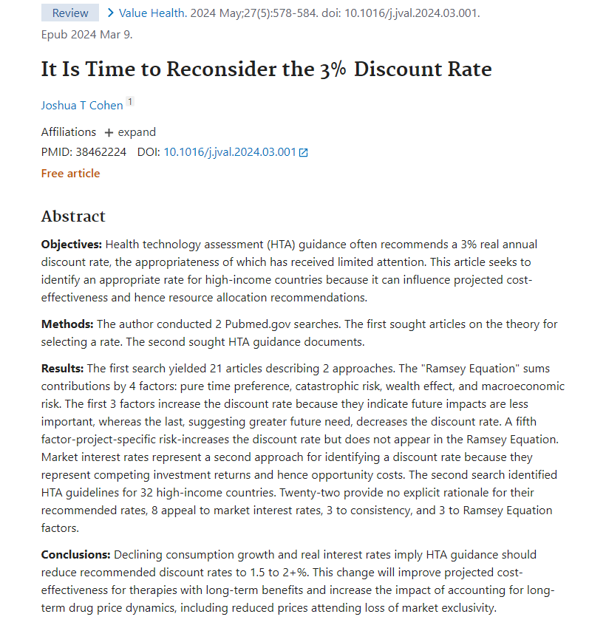
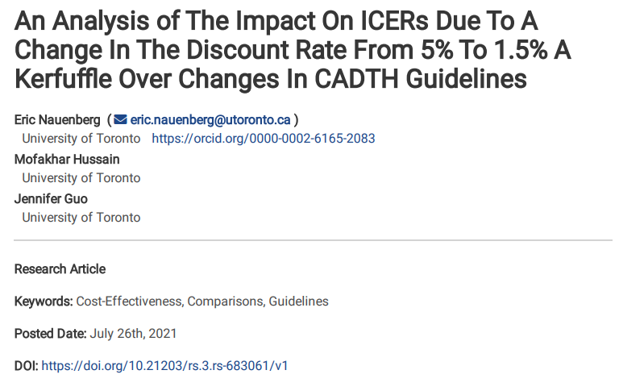
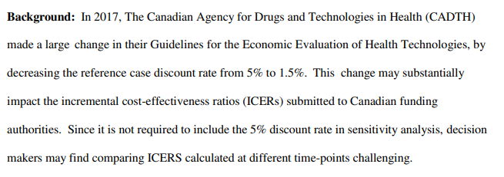
The two sides of the debate

Slide 24
Valuing Treatment Decisions Under ROI

Slide 25
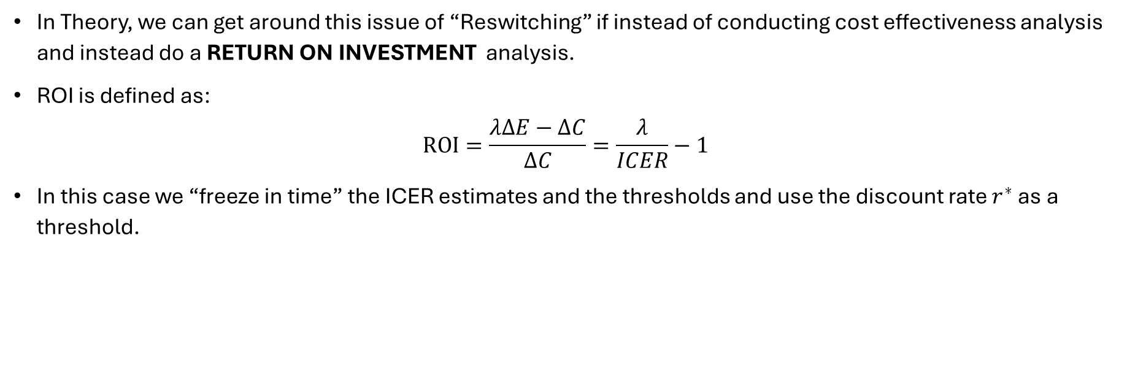
An Alternative– Valuing under ROI
In Theory, we can get around this issue of “Reswitching” if instead of conducting cost effectiveness analysis and instead do a RETURN ON INVESTMENT analysis.
ROI is defined as:
$ROI=\frac{λΔE−ΔC}{ΔC}=\frac{λ}{ICER}−1$
In this case we “freeze in time” the ICER estimates and the thresholds and use the discount rate $r^{∗}$ as a threshold.

Slide 26
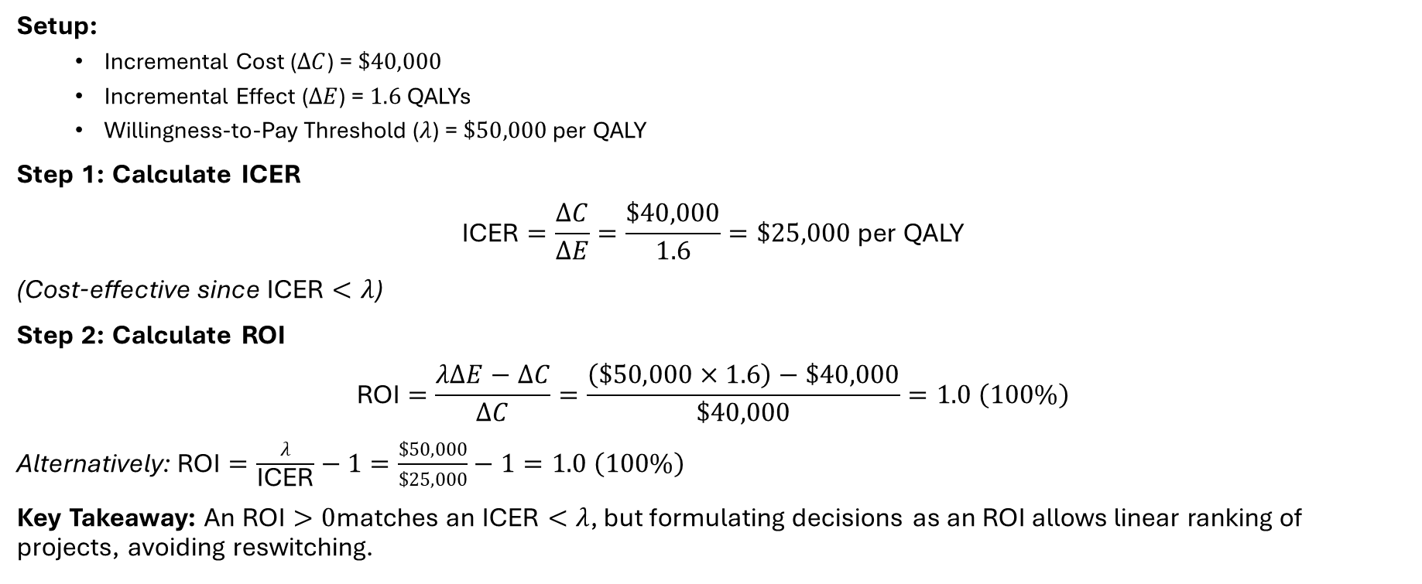
An Alternative– Valuing under ROI
Setup:
  Incremental Cost ($ΔC$) = $\$40,000$
  Incremental Effect ($ΔE$) = $1.6\text{ QALYs}$
  Willingness-to-Pay Threshold ($λ$) = $\$50,000\text{ per QALY}$
Step 1: Calculate ICER
$$\text{ICER}=\frac{ΔC}{ΔE}=\frac{\$40,000}{1.6}=\$25,000\text{ per QALY}$$
(Cost-effective since $\text{ICER}<λ$)
Step 2: Calculate ROI
$$\text{ROI}=\frac{λΔE−ΔC}{ΔC}=\frac{\left(\$50,000×1.6\right)−\$40,000}{\$40,000}=1.0 \left(100\%\right)$$
Alternatively: $\text{ROI}=\frac{λ}{\text{ICER}}−1=\frac{\$50,000}{\$25,000}−1=1.0 \left(100\%\right)$
Key Takeaway: An $\text{ROI}>0$matches an $\text{ICER}<λ$, but formulating decisions as an ROI allows linear ranking of projects, avoiding reswitching.

Slide 27

The unfortunate nature of health technology assessment.
While this transformation works. It Changes the analysis type and rules of the game.
As such you are now working with a data type that is different from others.
If the standard is to report the ICER, why Report ROI??

Slide 28
The Reality of Economic Evaluation

Slide 29
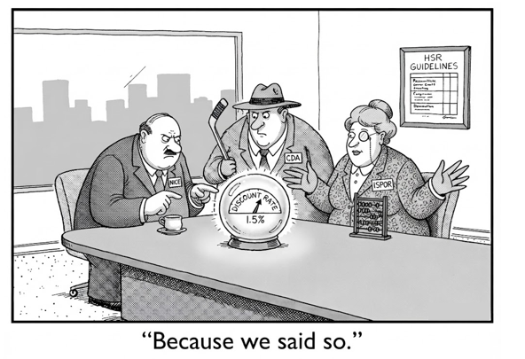
Concluding Remarks: Economic Evaluations must follow guidelines
To get anywhere with economic evaluation, whether in industry, academia or in government, you need to follow rules.
Reswitching exists, but current decision makers do not consider it because discount rates are very small (ranging between 0%-5%) even on a continuous frame, this is rare.
This does not mean it cant happen though.
FINAL WORD: If you want your work to go anwhere, follow guidelines.

